Slide 1
Software Engineering BCA IV SEM
Chapter VI
Software Testing and Quality Assurance
Bijay Babu Regmi
bijay.regmi@deerwalk.edu.np

Slide 2
Verification and Validation
In software project management, verification and validation (V&V) is the process of checking that a software system meets specifications and that it fulfills its intended purpose.
It may also be referred to as software quality control. It is normally the responsibility of software testers as part of the software development lifecycle.
Verification and validation are not the same thing, although they are often confused. Nexlesoft succinctly expressed the difference between
– Validation: Are we building the right product?
– Verification: Are we building the product right?

Slide 3
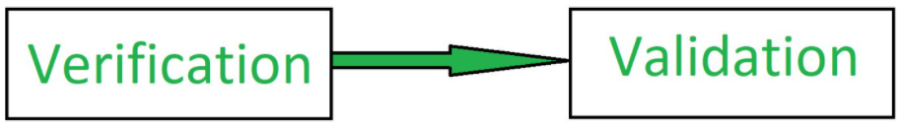
Continued….
Verification is the process of checking that a software achieves its goal without any bugs. It is the process to ensure whether the product that is developed is right or not. It verifies whether the developed product fulfills the requirements that we have. Verification is Static Testing. Activities involved in verification:
Inspections
Reviews
Walkthroughs
Desk-checking
Verification ensures the product being developed is according to design specifications.
Verification answers the question– "Are we developing this product by firmly following all design specifications ?"
Verifications concentrates on the design and system specifications.

Slide 4
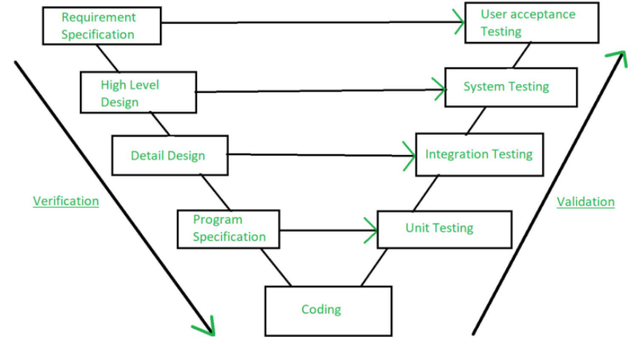
Continued….
Validation is the process of checking whether the software product is up to the mark or in other words product has high level requirements. It is the process of checking the validation of product i.e. it checks what we are developing is the right product. it is validation of actual and expected product. Validation is the Dynamic Testing. Activities involved in validation:
Black box testing
White box testing
Unit testing
Integration testing

Slide 5
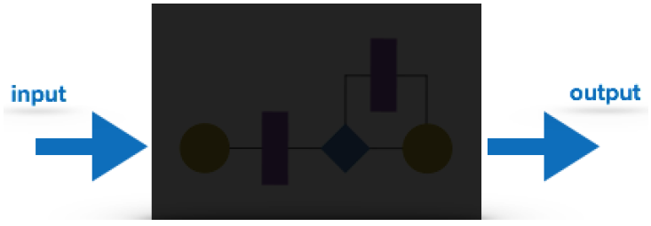
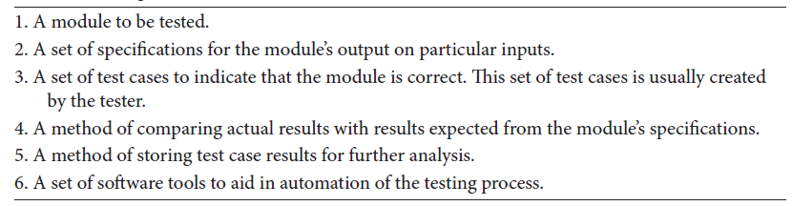
Techniques of Testing
Black Box Testing
It is carried out to test functionality of the program and also called ‘Behavioral’ testing. The tester in this case, has a set of input values and respective desired results. On providing input, if the output matches with the desired results, the program is tested ‘ok’, and problematic otherwise.
In this testing method, the design and structure of the code are not known to the tester, and testing engineers and end users conduct this test on the software.
Figure: Black Box Testing Table: Inputs to a Black Box Test Plan of a module

Slide 6
Continued….
Black-box testing techniques:
Equivalence class - The input is divided into similar classes. If one element of a class passes the test, it is assumed that all the class is passed.
Boundary values - The input is divided into higher and lower end values. If these values pass the test, it is assumed that all values in between may pass too.
Cause-effect graphing - In both previous methods, only one input value at a time is tested. Cause (input) – Effect (output) is a testing technique where combinations of input values are tested in a systematic way.
Pair-wise Testing - The behavior of software depends on multiple parameters. In pairwise testing, the multiple parameters are tested pair-wise for their different values.
State-based testing - The system changes state on provision of input. These systems are tested based on their states and input.

Slide 7
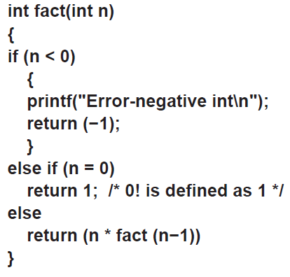
Continued….
Example:

Slide 8
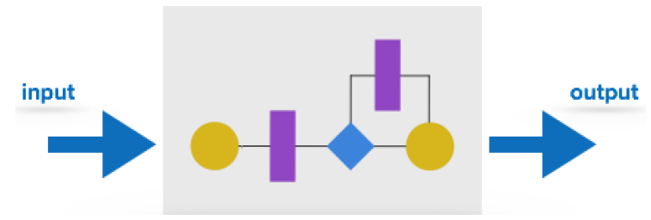
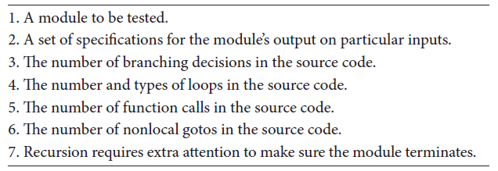
Continued….
White Box Testing
It is conducted to test program and its implementation, in order to improve code efficiency or structure. It is also known as ‘Structural’ testing.
In this testing method, the design and structure of the code are known to the tester. Programmers of the code conduct this test on the code.
Figure: White Box Testing Figure: Typical Inputs to a White Box Test Plan of Module

Slide 9
Continued….
White-box testing techniques:
Control-flow testing - The purpose of the control-flow testing to set up test cases which covers all statements and branch conditions. The branch conditions are tested for both being true and false, so that all statements can be covered.
Data-flow testing - This testing technique emphasis to cover all the data variables included in the program. It tests where the variables were declared and defined and where they were used or changed.

Slide 10
Levels of Testing
Testing itself may be defined at various levels of SDLC. The testing process runs parallel to software development. Before jumping on the next stage, a stage is tested, validated and verified.
Testing separately is done just to make sure that there are no hidden bugs or issues left in the software. Software is tested on various levels:
Unit Testing:
While coding, the programmer performs some tests on that unit of program to know if it is error free. Testing is performed under white-box testing approach. Unit testing helps developers decide that individual units of the program are working as per requirement and are error free. The main purpose behind this is to check that all the individual parts are working as intended. A unit is known as the smallest possible component of software that can be tested. Generally, it has a few inputs and a single output. The workflow of unit testing in software testing usually follows this framework:
Create the test cases
Review or rework
Baseline
Execute test cases

Slide 11
Continued….
ii) Integration Testing
It is a level of software testing where individual units / components are combined and tested as a group. The purpose of this level of testing is to expose faults in the interaction between integrated units. Test drivers and test stubs are used to assist in Integration Testing. Even if the units of software are working fine individually, there is a need to find out if the units if integrated together would also work without errors. For example, argument passing and data updating etc.
Unit Tested Module A
Unit Tested Module B
Integrated Module
+

Slide 12
Continued….
iii) System Testing
The software is compiled as product and then it is tested as a whole. This can be accomplished using one or more of the following tests:
Functionality testing - Tests all functionalities of the software against the requirement.
Performance testing - This test proves how efficient the software is. It tests the effectiveness and average time taken by the software to do desired task. Performance testing is done by means of load testing and stress testing where the software is put under high user and data load under various environment conditions.
Security & Portability - These tests are done when the software is meant to work on various platforms and accessed by number of persons.

Slide 13
Continued….
iv) Acceptance Testing
When the software is ready to hand over to the customer it has to go through last phase of testing where it is tested for user-interaction and response. This is important because even if the software matches all user requirements and if user does not like the way it appears or works, it may be rejected.
Alpha testing - The team of developer themselves perform alpha testing by using the system as if it is being used in work environment. They try to find out how user would react to some action in software and how the system should respond to inputs.
Beta testing - After the software is tested internally, it is handed over to the users to use it under their production environment only for testing purpose. This is not as yet the delivered product. Developers expect that users at this stage will bring minute problems, which were skipped to attend.

Slide 14
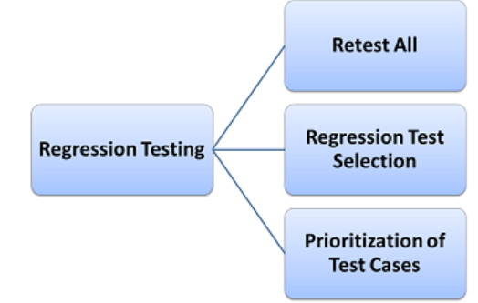
Continued….
v) Regression Testing
Whenever a software product is updated with new code, feature or functionality, it is tested thoroughly to detect if there is any negative impact of the added code. This is known as regression testing. It is defined as a type of software testing to confirm that a recent program or code change has not adversely affected existing features. Regression Testing is nothing but a full or partial selection of already executed test cases which are re-executed to ensure existing functionalities work fine.

Slide 15
Testing Documentation
Before Testing
Testing starts with test cases generation. Following documents are needed for reference –
SRS document - Functional Requirements document
Test Policy document - This describes how far testing should take place before releasing the product.
Test Strategy document - This mentions detail aspects of test team, responsibility matrix and rights/responsibility of test manager and test engineer.
Traceability Matrix document - This is SDLC document, which is related to requirement gathering process. As new requirements come, they are added to this matrix. These matrices help testers know the source of requirement. They can be traced forward and backward.

Slide 16
Continued….
While Being Tested
The following documents may be required while testing is started and is being done:
Test Case document - This document contains list of tests required to be conducted. It includes Unit test plan, Integration test plan, System test plan and Acceptance test plan.
Test description - This document is a detailed description of all test cases and procedures to execute them.
Test case report - This document contains test case report as a result of the test.
Test logs - This document contains test logs for every test case report.
After Testing
The following documents may be generated after testing :
Test summary - This test summary is collective analysis of all test reports and logs. It summarizes and concludes if the software is ready to be launched. The software is released under version control system if it is ready to launch.

Slide 17
Design of Test Cases
Boundary Value Analysis (BVA)
Boundary value analysis is based on testing at the boundaries between partitions. It includes maximum, minimum, inside or outside boundaries, typical values and error values.
It is generally seen that a large number of errors occur at the boundaries of the defined input values rather than the center. It is also known as BVA and gives a selection of test cases which exercise bounding values.
Example:
Input Condition is valid between 1 to 10
Boundary values 0,1,2 and 9,10,11

Slide 18
Continued….
Equivalence Class Partitioning
Equivalent Class Partitioning allows you to divide set of test condition into a partition which should be considered the same. This software testing method divides the input domain of a program into classes of data from which test cases should be designed.
The concept behind this technique is that test case of a representative value of each class is equal to a test of any other value of the same class. It allows you to Identify valid as well as invalid equivalence classes.
Example: Input conditions are valid between 1 to 10 and 20 to 30
Hence there are five equivalence classes
i) ---- to 0 (invalid)
ii) 1 to 10 (valid)
iii) 11 to 19 (invalid)
iv) 20 to 30 (valid)
v) 31 to ---- (invalid)
You select values from each class i.e. -2, 3, 15, 25, 45

Slide 19
Continued….
Decision Table Testing
In this technique, test cases are designed on the basis of the decision tables that are formulated using different combinations of inputs and their corresponding outputs based on various conditions and scenarios adhering to different business rules.
The first task is to identify functionalities where the output depends on a combination of inputs. If there are large input set of combinations, then divide it into smaller subsets which are helpful for managing a decision table.
For every function, you need to create a table and list down all types of combinations of inputs and its respective outputs. This helps to identify a condition that is overlooked by the tester.
Example: A submit button in a contact form is enabled only when all the inputs are entered by the end user.

Slide 20
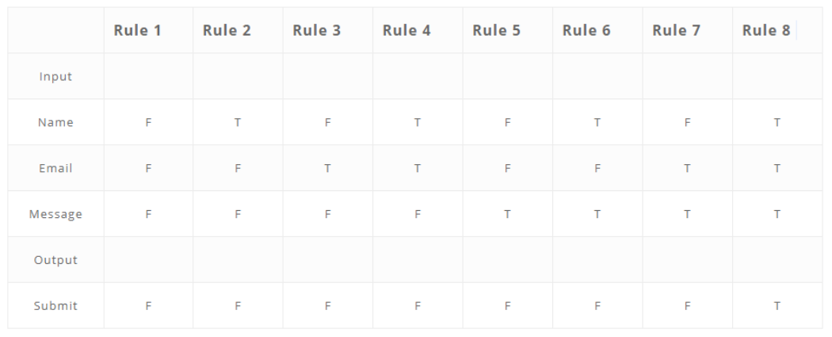
Continued….

Slide 21
Continued….
In this technique, the software under test is perceived as a system having a finite number of states of different types. The transition from one state to another is guided by a set of rules. The rules define the response to different inputs.
This technique can be implemented on the systems which have certain workflows within them.
This testing technique allows the tester to test the behavior of an AUT(Application Under Test). The tester can perform this action by entering various input conditions in a sequence.
In State transition technique, the testing team provides positive as well as negative input test values for evaluating the system behavior.

Slide 22
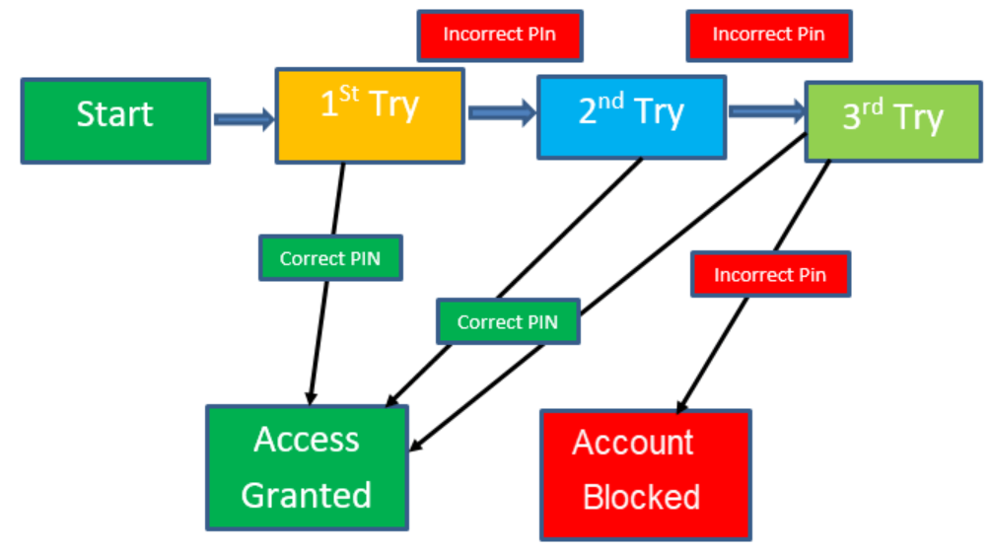
Continued….
Figure: State Transition Diagram

Slide 23
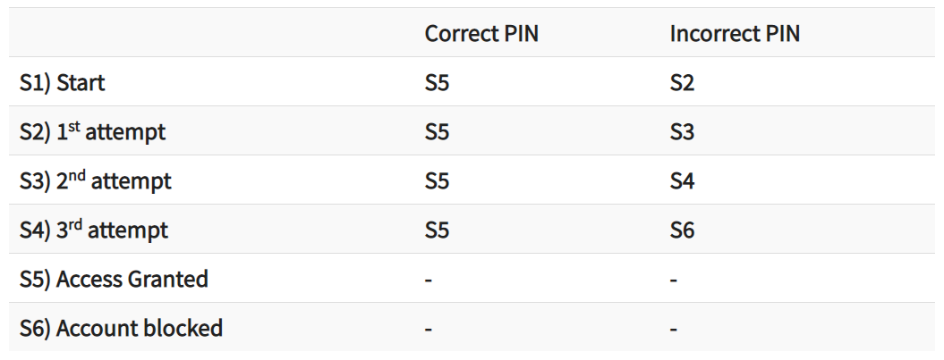
Continued….
Figure: State Transition Table

Slide 24
Continued….
Error Guessing
Error Guessing is a software testing technique based on guessing the error which can prevail in the code.
The technique is heavily based on the experience where the test analysts use their experience to guess the problematic part of the testing application.
The technique counts a list of possible errors or error-prone situations. Then tester writes a test case to expose those errors.
To design test cases based on this software testing technique, the analyst can use the past experiences to identify the conditions.

Slide 25
Software Quality Management
Software quality management is a comprehensive process that ensures software is compliant with its requirements, national and international quality standards, for example, established by ANSI, IEEE, and ISO. Quality management comprises the following activities: quality control (QC), quality assurance (QA), and quality planning (QP).
Quality control is a tip of quality management. As a rule, it’s observed even when the rest of quality management is overlooked. This product-oriented quality management component starts simultaneously with software development. QC includes software testing activities predetermined by a quality plan. Manual and automated functionality, performance, integration, usability, security, regression testing – all these and many other testing types comprise QC. Quality control should check whether software is compliant with its requirements and no severe defects will be revealed after software is released.

Slide 26
Continued….
Quality assurance is a process-oriented part of quality management, which should be introduced as early as a project planning stage. QA deals with the following questions:
What standards and requirements software should comply with?
What should each stakeholder (for example, project managers, BAs, and developers) do for software to be of high quality?
What kind of the software production process can prevent defects from occurring?
How to establish such a process?

Slide 27
Continued….
Quality planning: A quality plan can be devoted either to general enterprise-wide quality management practices or quality provision during each project specifically. On a project level, QP normally formalizes such aspects of quality management as:
- Stakeholders’ roles and responsibilities with regard to quality assurance.
- Required project and testing documentation.
- A software requirements specification and the set of standards software should comply with.
- Relevant testing types.
- An approximate testing schedule, cost, and human resources line-up for the corresponding project.
- Training required by QA team members.
- A reporting process and schedule.

Slide 28
Process and Product Quality
Process quality refers to the degree to which an acceptable process, including measurements and criteria for quality, has been implemented and adhered to in order to produce the artifacts.
The objectives of measuring and assessing process quality are to:
- Manage profitability and resources
- Manage and resolve risk
- Manage and maintain budgets, schedules, and quality
- Capture data for process improvement
To some degree, adhering to a process and achieving high process quality overlaps somewhat with the quality of the artifacts. That is, if the process is adhered to (high quality), the risk of producing poor quality artifacts is reduced. However, the opposite is not always true—generating high quality artifacts is not necessarily an indication that the process has been adhered to.
Therefore, process quality is measured not only to the degree to which the process was adhered to, but also to the degree of quality achieved in the products produced by the process.

Slide 29
Continued….
To aid in your evaluation of the process and product quality, the Rational Unified Process (RUP) has included pages such as:
Activity: a description of the activity to be performed and the steps required to perform the activity.
Work Guideline: techniques and practical advice useful for performing the activity.
Artifact Guidelines and Checkpoints: information on how to develop, evaluate, and use the artifact.
Templates: models or prototypes of the artifact that provide structure and guidance for content.

Slide 30
Continued….
Product Quality is defined in term of its fitness of purpose. That is, a quality product does precisely what the users want it to do. For software products, the fitness of use is generally explained in terms of satisfaction of the requirements laid down in the SRS document.
Example: Consider a functionally correct software product. That is, it performs all tasks as specified in the SRS document. But, has an almost unusable user interface. Even though it may be functionally right, we cannot consider it to be a quality product.
Features of modern quality product are:
Portability: A software device is said to be portable, if it can be freely made to work in various operating system environments, in multiple machines, with other software products, etc.
Usability: A software product has better usability if various categories of users can easily invoke the functions of the product.
Reusability: A software product has excellent reusability if different modules of the product can quickly be reused to develop new products.
Correctness: A software product is correct if various requirements as specified in the SRS document have been correctly implemented.
Maintainability: A software product is maintainable if bugs can be easily corrected as and when they show up, new tasks can be easily added to the product, and the functionalities of the product can be easily modified, etc.

Slide 31
ISO 9000 Standard
ISO 9000 is defined as a set of international standards on quality management and quality assurance developed to help companies effectively document the quality system elements needed to maintain an efficient quality system. They are not specific to any one industry and can be applied to organizations of any size.
ISO 9000 can help a company satisfy its customers, meet regulatory requirements, and achieve continual improvement. It should be considered to be a first step or the base level of a quality system.
The phrase “ISO 9000 family” or “ISO 9000 series” refers to a group of quality management standards which are process standards (not product standards).
ISO 9000 Quality management systems – Fundamentals and Vocabulary, referenced in all ISO 9000 Standards.
ISO 9001 Quality management systems – Requirements, contains the requirements an organization must comply with to become ISO 9001 certified.
ISO 9002 – Guidelines for the application of ISO 9001:2015
ISO 9004 – Managing for the sustained success of an organization, provides guidelines for sustaining QMS success through evaluation and performance improvement.

Slide 32
Continued….
As with anything, there are ISO 9000/9001 pros and cons. The application of ISO 9001 when implementing a quality management system can provide the following benefits the organizations:
Clear understanding of your objectives and new business opportunities.
Identifying and addressing the risks associated with your organization.
Renewed emphasis on putting your customers first.
Meeting the necessary statutory and regulatory requirements.
Organizational and process alignment to increase productivity and efficiency.
An organization must demonstrate the following in order to be ISO 9001 certified:
The company follows the guidelines within the ISO 9001 standard;
The company meets its own requirements;
The company meets its customer requirements and statutory and regulatory requirements; and
The company maintains documentation of its performance.

Slide 33
Capability Maturity Model (CMM)
CMM was developed by the Software Engineering Institute (SEI) at Carnegie Mellon University in 1987.
It is not a software process model. It is a framework which is used to analyze the approach and techniques followed by any organization to develop software products.
It also provides guidelines to further enhance the maturity of the process used to develop those software products.
It is based on profound feedback and development practices adopted by the most successful organizations worldwide.
This model describes a strategy for software process improvement that should be followed by moving through 5 different levels.
Each level of maturity shows a process capability level. All the levels except level-1 are further described by Key Process Areas (KPA’s).

Slide 34
Continued…..
CMM's Five Maturity Levels of Software Processes
At the initial level, processes are disorganized, even chaotic. Success is likely to depend on individual efforts, and is not considered to be repeatable, because processes would not be sufficiently defined and documented to allow them to be replicated.
At the repeatable level, basic project management techniques are established, and successes could be repeated, because the requisite processes would have been made established, defined, and documented.
At the defined level, an organization has developed its own standard software process through greater attention to documentation, standardization, and integration.
At the managed level, an organization monitors and controls its own processes through data collection and analysis.
At the optimizing level, processes are constantly being improved through monitoring feedback from current processes and introducing innovative processes to better serve the organization's particular needs.

Slide 35
References
https://asq.org/quality-resources/iso-9000#:~:text=ISO%209000%20is%20defined%20as,to%20organizations%20of%20any%20size.

